Slide 1
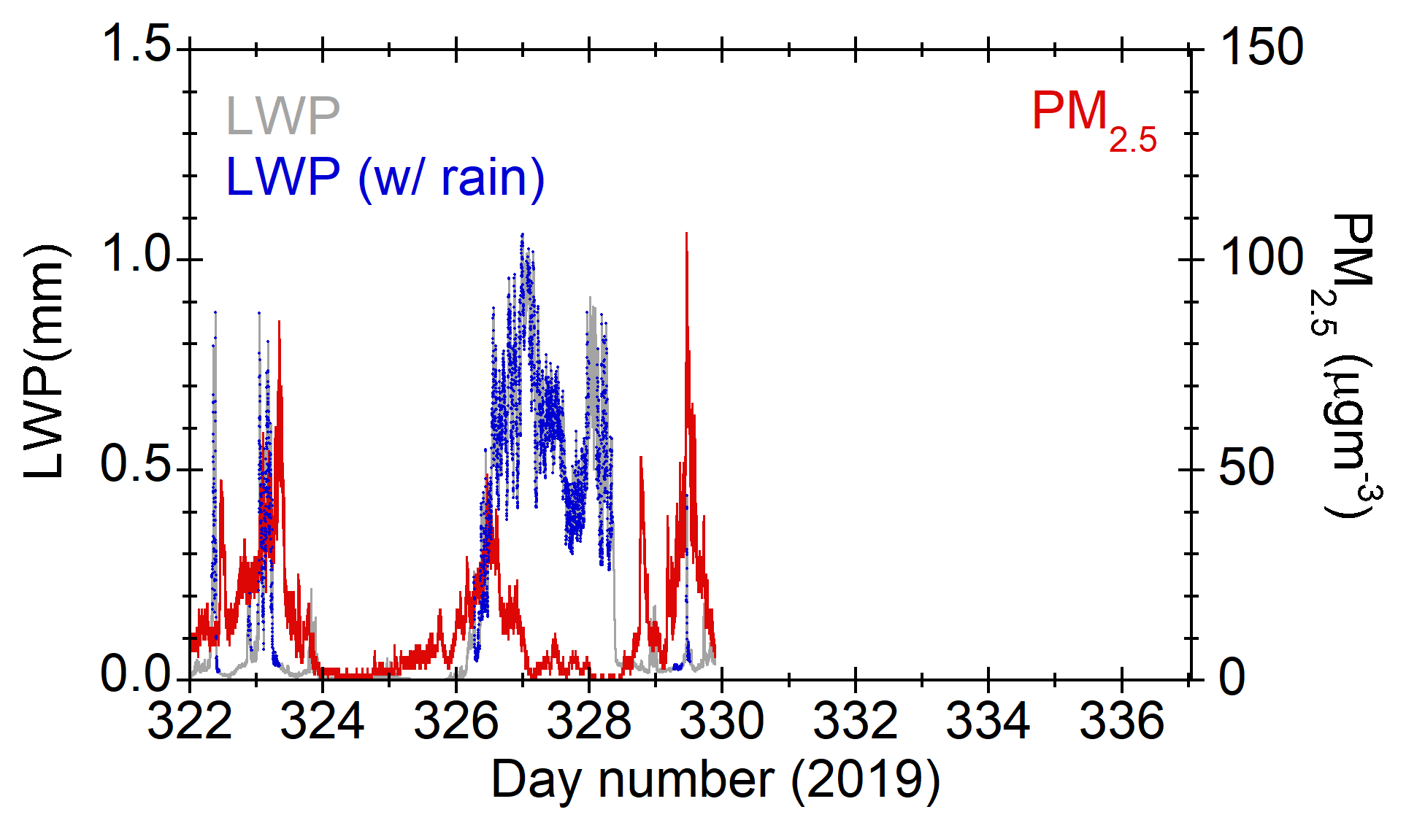
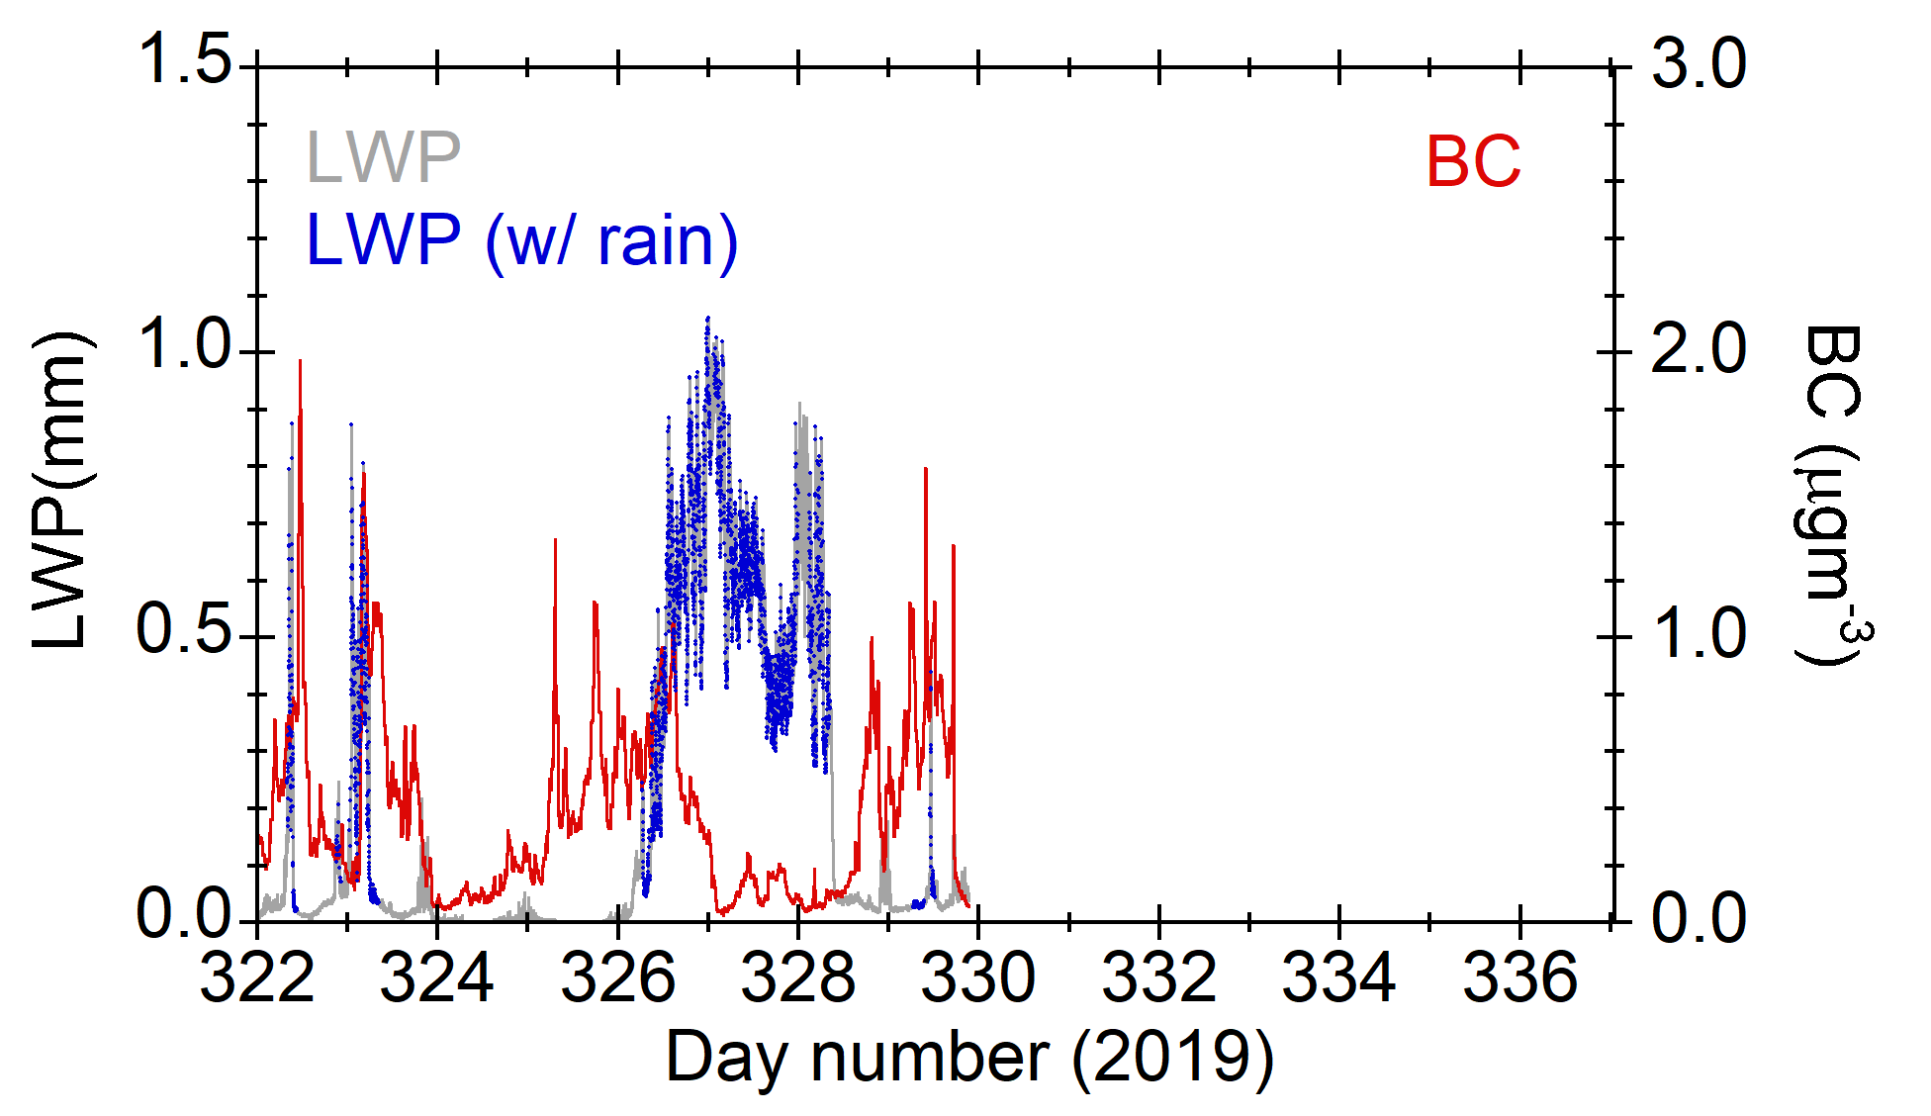
What happened in PM2.5 and BC with precipitation?
High PM_{2.5} and BC were observed even precipitation occurred. → why?

